Slide 1



ZaNuri
By Shatulo Chikumbe
01

Slide 2

Problem Statement
Lusaka is facing a silent health crisis driven by dietary changes.
  The rising incomes are shifting diets towards processed foods, leading to an explosion of lifestyle diseases (diabetes, hypertension) while undernutrition and micronutrient deficiencies persist.
  Generic health advice fails to account for individual factors: budget, cultural preferences, local food availability, health conditions, and taste.
  Busy urban families struggle to plan meals that are healthy, affordable, and satisfying, leading to poor choices and food waste.
10

Slide 3

Solution
  AI-Driven Personalization: Our algorithm creates unique nutrition and meal plans based on individual health data, goals, budget, annd taste preferences.
  Culturally & Locally Intelligent: Our database is built on Zambian staples, local recipes, and real-time data from Lusaka markets, ensuring relevance and practicality.
  Seamless Integration: We bridge the gap between planning and eating. Get a personalized plan, a smart shopping list, and direct access to a network of vendors for delivery or pickup.
06

Slide 4

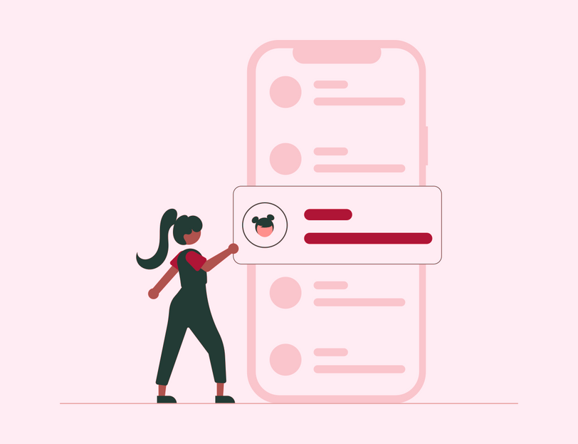



Product
Create Account and conduct a 2-minute health quiz
Dynamic Meal Planner
Smart Shopping List
Vendor Marketplace
Progress Tracker
04

Slide 5



Target Market
3 out 5
Most health-conscious urban professionals and parents in Lusaka (aged 25-45) with smartphones are busy.
60%
Have disposable income, and are actively seeking solutions for their family's health.
60,000
This will be the number of users based in Lusaka
14

Slide 6
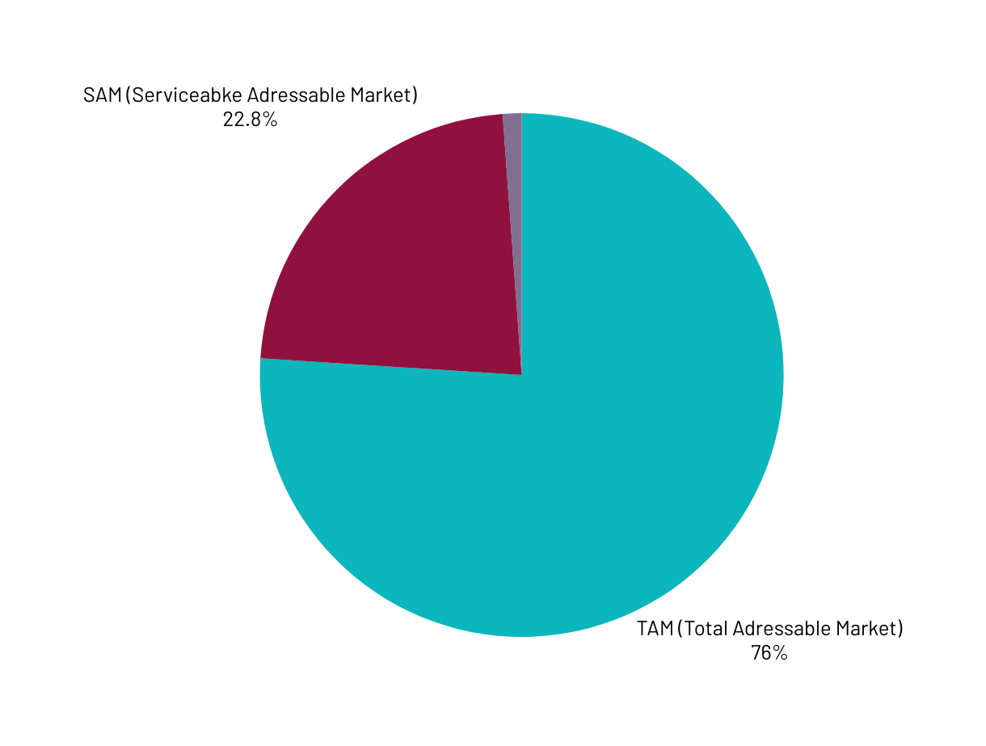
Market Size
  TAM (Total Addressable Market): About 4 million Zambian households have universal need for nutrition.
  SAM (Serviceable Addressable Market): Urban households in Lusaka and other major towns with mobile internet access are about 1.2 million people.
  SOM (Serviceable Obtainable Market): Aim to capture 5% of Lusaka's health-conscious urban population within 3 years which translates to 60,000 users.

Slide 7
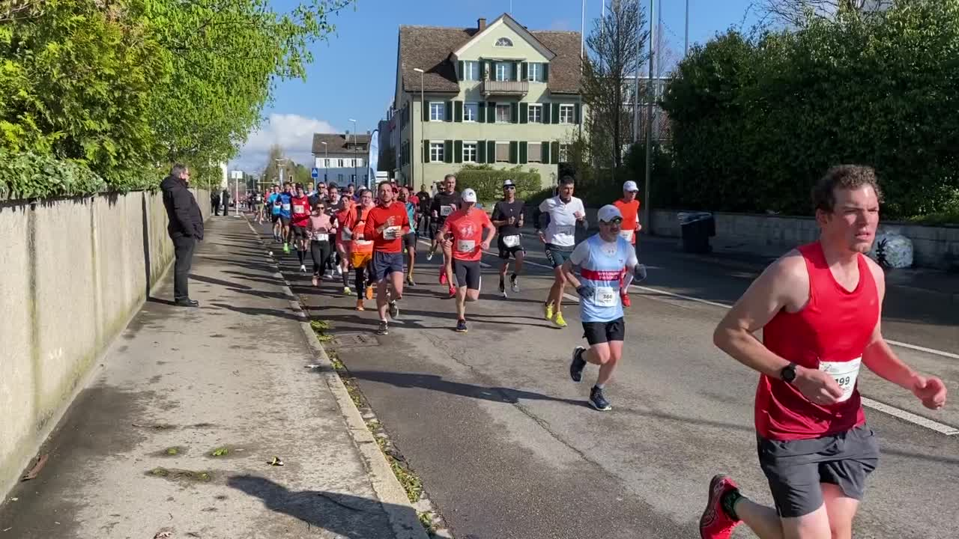
Competitors
Competitor: MyFitnessPal
Offering: Global calorie counter
ZaNuri’s Advantage: Not localized and doesn't understand Zambian foods, portions, or budgets.
Competitor: WhatsApp Groups
Offering: Word-of-mouth recipe sharing
ZaNuri’s Advantage: Not personalized, chaotic, and time-consuming.
Competitor: Local Dieticians
Offering: 1-on-1 consultation
ZaNuri’s Advantage: Excellent but expensive (>ZMW 500/session) and not scalable.
Gap: None offer Zambian food-focused AI personalization integrated with local supply chains.
23

Slide 8

Competitive Advantage
  The Data Moat: Our AI becomes smarter and more uniquely Zambian with every user. This deep, localized dataset is impossible for global apps to replicate quickly.
  The Ecosystem Moat: We connect two sides of the market (consumers and vendors), creating a powerful network effect. More users attract more vendors, which improves the service for all users.
  Cultural Trust Moat: We are built by Zambians, for Zambians. Our team's deep cultural understanding ensures relevance and trust, which is critical in the food sector.
  Capital-Efficient Model: Our asset-light approach, partnering with existing vendors, allows for rapid scaling without heavy infrastructure investment.

Slide 9
Project Traction
Tasks
Aug - Sep 2025
Sep - Oct 2025
Oct - Nov 2025
Nov - Dec 2025
Dec - Jan 2025/26
Conduct Market Research
Define Product Features
Prototype Development
Begin Development
User Testing
MVP Launched
Early Validation
Initial Partnerships
23

Slide 10

Business Model
Freemium Subscription:
  Basic: Free (meal plans, shopping lists - ad-supported).
  Premium (ZMW 45/month or ZMW 450/year): Ad-free, advanced analytics, exclusive recipes, dietitian chat support.
Transaction Fees: 5-10% commission on all sales generated through our vendor marketplace.
B2B SaaS Licensing: ZMW 100 Monthly fee per employee for corporate wellness packages offered to companies.
Anonymized Data Insights: Sell aggregated, anonymized trend data to FMCG companies and agricultural agencies.
23

Slide 11
Go To Market
  Phase 1: Digital-First Community Building: Targeted social media campaigns (Facebook, Instagram, TikTok, and WhatsApp) focusing on health, parenting, and local food groups in Lusaka.
  Phase 2: Strategic On-the-Ground Partnerships:
    Gyms & Clinics/Hospitals: Offer discounts to their members/patients.
    Corporate Partnerships: Pilot with 2-3 major Lusaka-based companies for their staff.
    Vendor Onboarding: Aggressively sign up popular market stalls and supermarkets.
  Phase 3: Local Influencer & Radio Marketing: Partner with trusted local nutritionists, chefs, and health influencers for credibility. Use local radio for mass reach.

Slide 12
Social Impact
Our mission is deeply intertwined with positive societal change:
  Improving Public Health: Empowering individuals to prevent and manage diet-related diseases, reducing the future burden on the national healthcare system.
  Boosting Local Economies: Creating a predictable revenue stream for local smallholder farmers and vendors by connecting them directly to consumers.
  Reducing Food Waste: Smart planning and lists ensure users only buy what they need, reducing household food waste.
  Promoting Food Security: Making healthy eating knowledge and resources accessible and affordable to a broader segment of the population, not just the wealthy.

Slide 13
Our Ask
We are seeking $200,000 in seed funding for 15% equity.
Use of Funds:
  50% - Product & Tech Development: Hiring 2 full-time developers, API costs, and platform scaling.
  25% - Marketing & User Acquisition: Digital marketing, partnership development, and community events.
  15% - Team Expansion: Hiring key roles for Business Development and Community Management.
  10% - Legal & Operational Buffer.

Slide 14
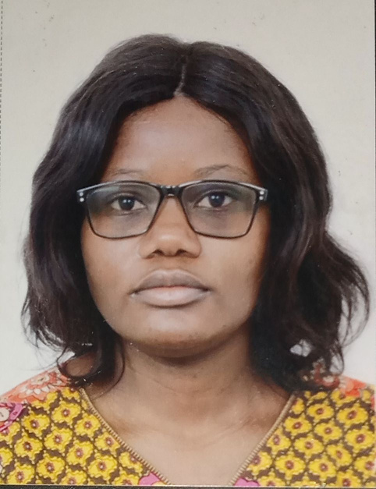
Team Members
SHATULO CHIKUMBE
FOUNDER/CEO

Slide 15



Thank you!
Email: chikumbeshats4@gmail.com
Linkedin
17

